Slide 1

Western Michigan University
CS-5610 Advanced R for Data Science
PROJECT – EXPLORATORY DATA ANALYSIS FOR PREOPERATIVE BRAIN GLIOMA MRI

Slide 2
Motivation
The brain is an important organ in the human body. But sometimes organs are affected by various diseases that affected human bodies.
Here we took an approach where we will deal with various information that is actually there to create brain disease.
And make an exploratory data analysis to understand these disease-related factors that can cause brain problems in the human body.

Slide 3
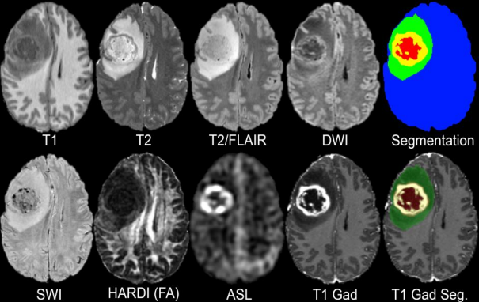
Brain Glioma
A brain glioma is a type of tumor that arises from the supportive cells in the brain called glial cells.
Glial cells provide structural support to neurons and are involved in various functions of brain.
The symptoms of a brain glioma depend on the size and location of the tumor and may include headaches, changes in vision, and difficulty with speech or motor functions.

Slide 4
Dataset
Cancer imaging archive is used for collection of data for the analysis to be made.
Includes a population consisting of 501* adult patients.
Confirmed grade II-IV diffuse gliomas who underwent preoperative MRI, tumor resection, and tumor genetic testing at a single medical Center.

Slide 5
Code - Libraries Used:
dplyr
glmnet
skimr
tidyr
readr
tidyverse
summarytools
shiny

Slide 6
Code - Steps
For predictions: Loading & cleaning the data
Exploring the dataset
Defining UI and server.
For EDA: Data loading
Defining the UI & server
Assigning input variable to get desired plot for analysis.

Slide 7
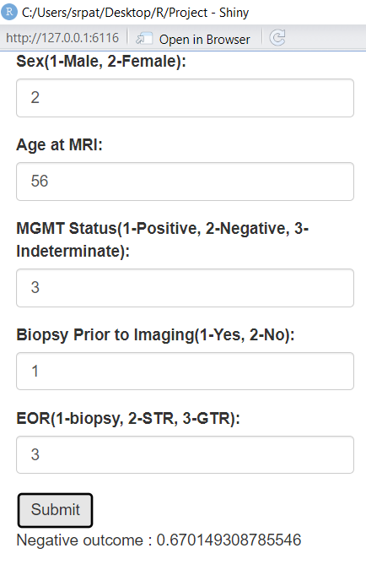
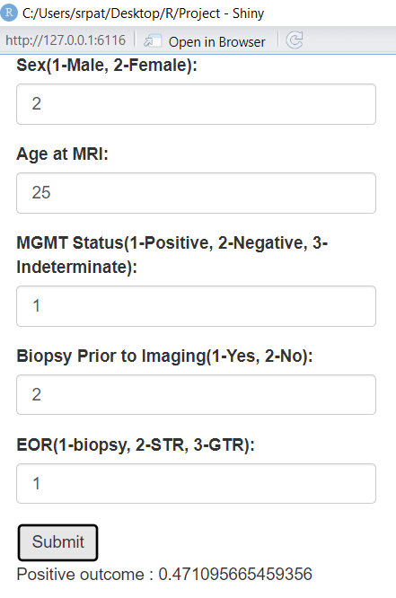
Analysis - Predictions
As we provide the inputs for the random scenario it will shiny app will predict the percentage of survival of the patient.
Positive outcome is below 0.5 which says patient may survive with the treatments.
Negative outcome is above 0.51 where patients may not survive.
May not survive
May survive

Slide 8
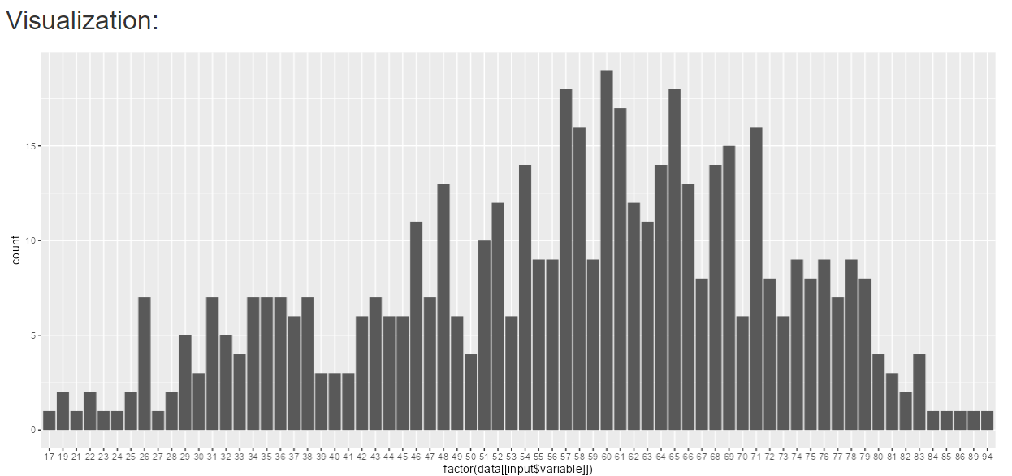
Analysis - EDA
This bar graph is obtained by variable Age at MRI which shows that most of the patients suffering from brain glioma are between 51 to 78 years of age.

Slide 9
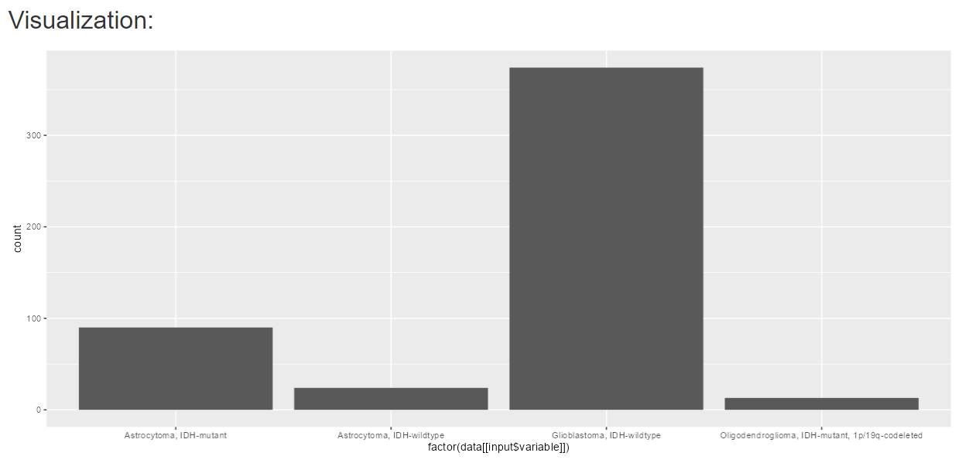
Analysis - EDA
This is second example from the analysis with final pathological diagnosis which shows that more than 350/501 patients are suffering with Glioblastoma(wildtype) which is most deadliest brain glioma.

Slide 10
Summary
Considering the prediction inputs we can get 133,056 different predictions for patients with their conditions of disease.
With EDA we get approx. 44 different graphs of patients with 11 different variables.

Slide 11
Thank You!!

